Slide 1
Spartacus Enablement Server Side Rendering
Tobias Ouwejan, SAP

Slide 2
SSR
Goal
Enable SSR support in the app
Build and start SSR server
Disabling components for SSR
Topics
SSR and Angular Universal
SSR Coding Guidelines
Universal Components
SSR Transfer State

Slide 3
Resources
Documentation
https://sap.github.io/cloud-commerce-spartacus-storefront-docs/Server-Side-Rendering-in-Spartacus/
https://sap.github.io/cloud-commerce-spartacus-storefront-docs/Server-Side-Rendering-Coding-Guidelines/
https://sap.github.io/cloud-commerce-spartacus-storefront-docs/Configurable-State-Persistence-and-Rehydration

Slide 4

Server Side Rendering (SSR)
Web Client
Web Crawler
state
cached resources
cached resources
cached resources
cached resources
Distributed Edge Cache (CDN)
transfer state
cache-control
Static Content (JPS, PNG)
Static Application (JS, CSS)
Backend (REST API)
SSR (NODEJS)
state
cached resources

Slide 5
Adding SSR support to your App
Install additional dependencies
Prepare angular build for server platform "@angular/platform-server"
Create express server using "@nguniversal/express-engine„
Enable SSR Transfer State support
Add script commands to package.json
https://sap.github.io/cloud-commerce-spartacus-storefront-docs/Server-Side-Rendering-in-Spartacus/

Slide 6
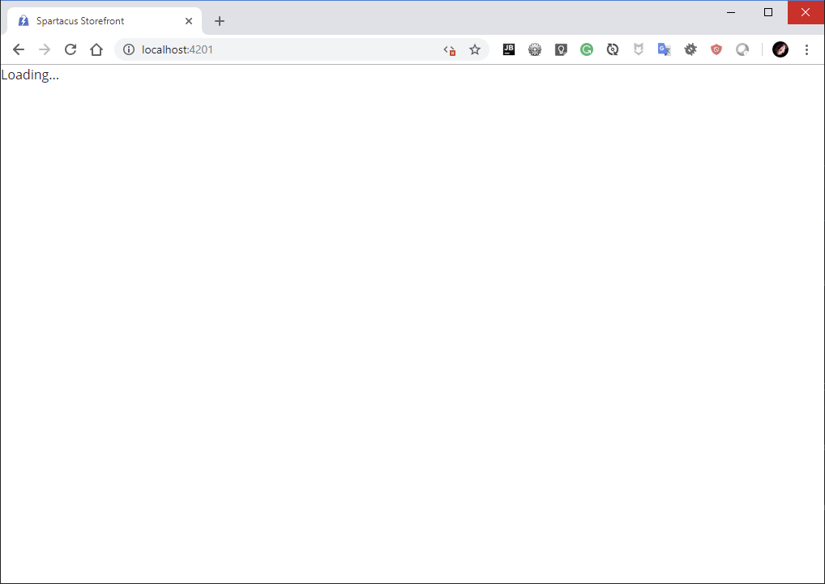
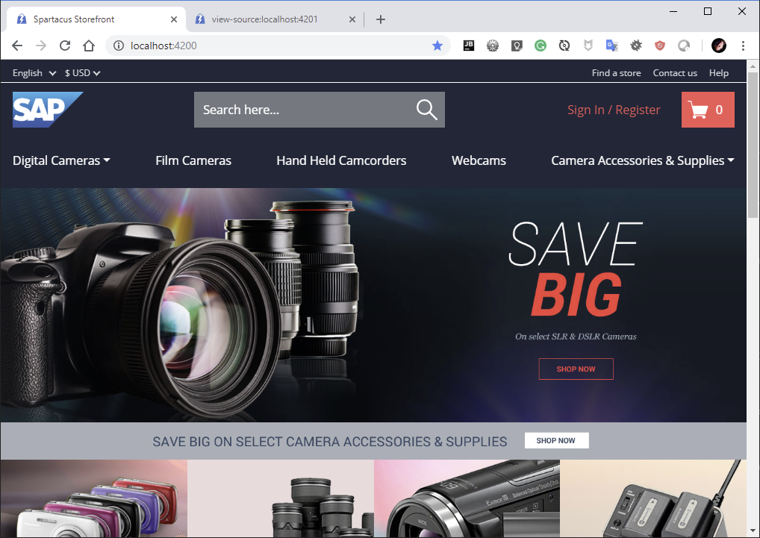
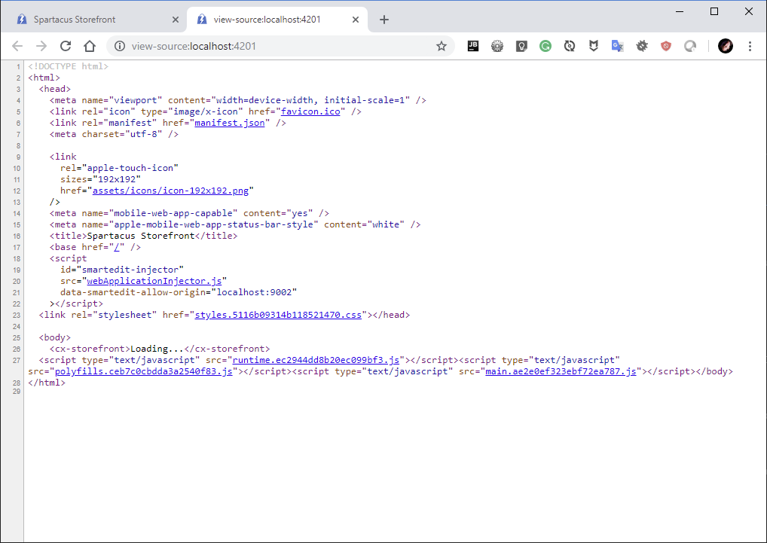
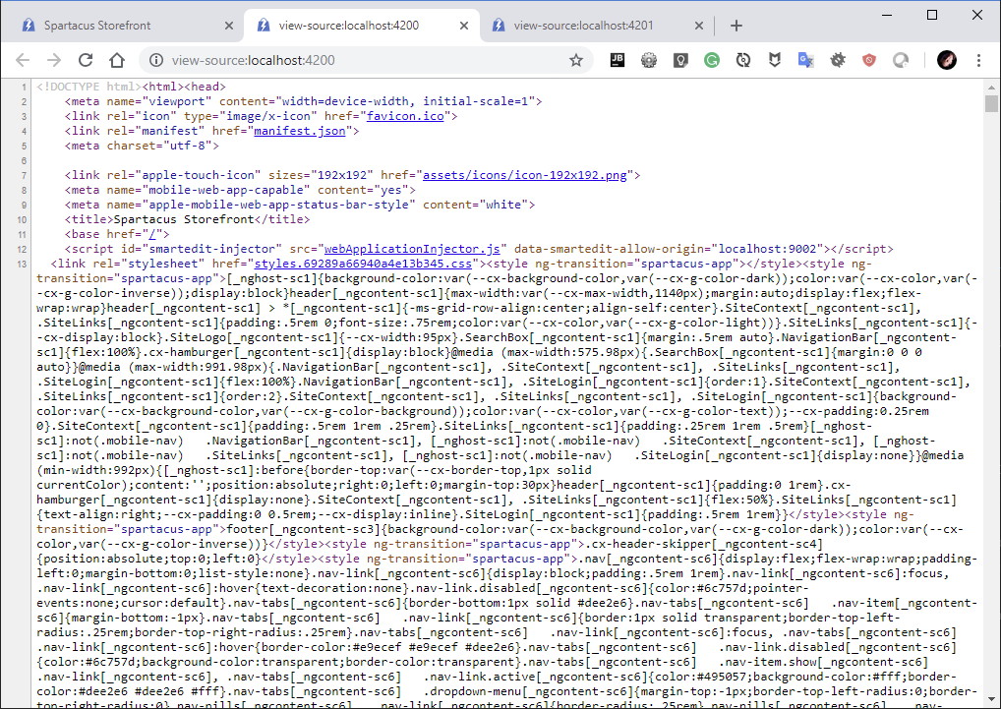
Building and Running SSR server
Disable PWA suport for testing { pwa: { enabled: false }}
yarn build:ssr
yarn serve:ssr
Check page source (Ctrl + U)
Disable JavaScript in the browser
VS

Slide 7
Debugging and Troubleshooting SSR
Start SSR server
Debugging nodeJs process in VS Code:
https://code.visualstudio.com/docs/nodejs/nodejs-debugging
Add debug configuration „Node.js Attach to process”
Start debugging session
Choose SSR process from the list
Optionally set breakpoint to „All exceptions”
Open webpage to initiate SSR rendering

Slide 8
Coding Guidelines / How not to break SSR
Because a Universal app doesn't execute in the browser, some of the browser APIs and capabilities may be missing on the server.
Use WindowRef instead of natively accessing window object (or other browser related stuff)
Don't manipulate the nativeElement directly (use the Renderer2)
Limit or avoid using timeouts in code
https://sap.github.io/cloud-commerce-spartacus-storefront-docs/Server-Side-Rendering-Coding-Guidelines/

Slide 9
Disabling Components in SSR
cmsComponents: { ProductAddToCartComponent: { disableSSR: true } },
https://sap.github.io/cloud-commerce-spartacus-storefront-docs/Customizing-CMS-Components/#controlling-server-side-rendering-ssr

Slide 10
Disabling Components in SSR
CMS components by default render in SSR
Disable this for specific components that should not be exposed with SSR
ConfigModule.withConfig(<CmsConfig>{
cmsComponents: {
ProductAddToCartComponent: {
component: AddToCartComponent,
disableSSR: true
}
}
})

Slide 11
Control SSR in code
constructor( @Inject(PLATFORM_ID) protected platformId: any ) {}
if (isPlatformBrowser(this.platformId)) {
// code will execute only on server
}
if (isPlatformServer(this.platformId)) {
// code will execute only on server
}

Slide 12
Use SSR Transfer state
Remove redundant backend calls
Remove flickering
https://sap.github.io/cloud-commerce-spartacus-storefront-docs/Configurable-State-Persistence-and-Rehydration/

Slide 13
Using SSR Transfer State
Remove redundant backend calls
Remove flickering
Use StateConfig
{
state: {
ssrTransfer: {
keys: {
product: StateTransferType.TRANSFER_STATE
}
}
}
} as StateConfig

Slide 14
Learn by doing
Add SSR support to your App
Disable “add to cart” button in SSR

Slide 15
Questions? Shoot!
Tobias Ouwejan
Lead Architect Commerce, SAP Customer Experience
tobias.ouwejan@sap.com
https://github.com/tobi-or-not-tobi/

